Slide 1
运用科研工具开拓视野，展示科研能力，发表高水平科研成果
李梦瑶
Mengyao Li
Customer Consultant
m.li@elsevier.com
励德爱思唯尔信息技术（北京）有限公司
Reed Elsevier Information Technology (Beijing) Co., Ltd
2019 May

Slide 2

History of Elsevier
ScienceDirect
Search Tips
New Features
Q & A

Slide 3
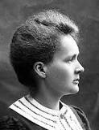
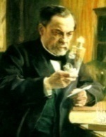
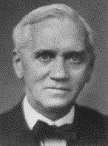


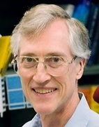


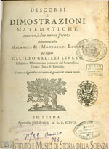
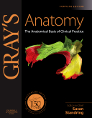

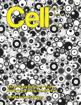
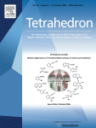
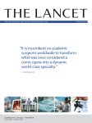




Elsevier在科学，技术和健康方面声誉卓越
Marie Curie (Physics, Chemistry)
Louis Pasteur (Chemistry)
Alexander Fleming
(Medicine)
Albert Einstein (Physics)
Shinya
Yamanaka
(Medicine)
John C. Mather (Physics)
Francoise
Barre-Sinoussi
(Medicine)
Craig C Mello (Medicine)
Galileo’s last and greatest work, published in 1638 by Elzevir, Discorsi e Dimostrazioni Matematiche
Notes:
Our customers are doing momentous things, and we are uniquely positioned to show our customers the ‘art of the possible’. For more than 130 years we have shared their commitment to transforming and advancing science, health and technology. We understand the worlds in which clinicians, educators, and academic and corporate researchers work, the outcomes they want to achieve and the challenges they face in achieving them. (Pictures are some of the Nobel Laureates publishing in our journals). We have a responsibility to use that understanding to create highly effective solutions that enable our customers to leverage the vast potential of information to advance science, health and technology in ways that they could not do alone, and to anticipate the new ways customers will want to use information in the future. That is what we mean by ‘leading the way’.

Slide 4
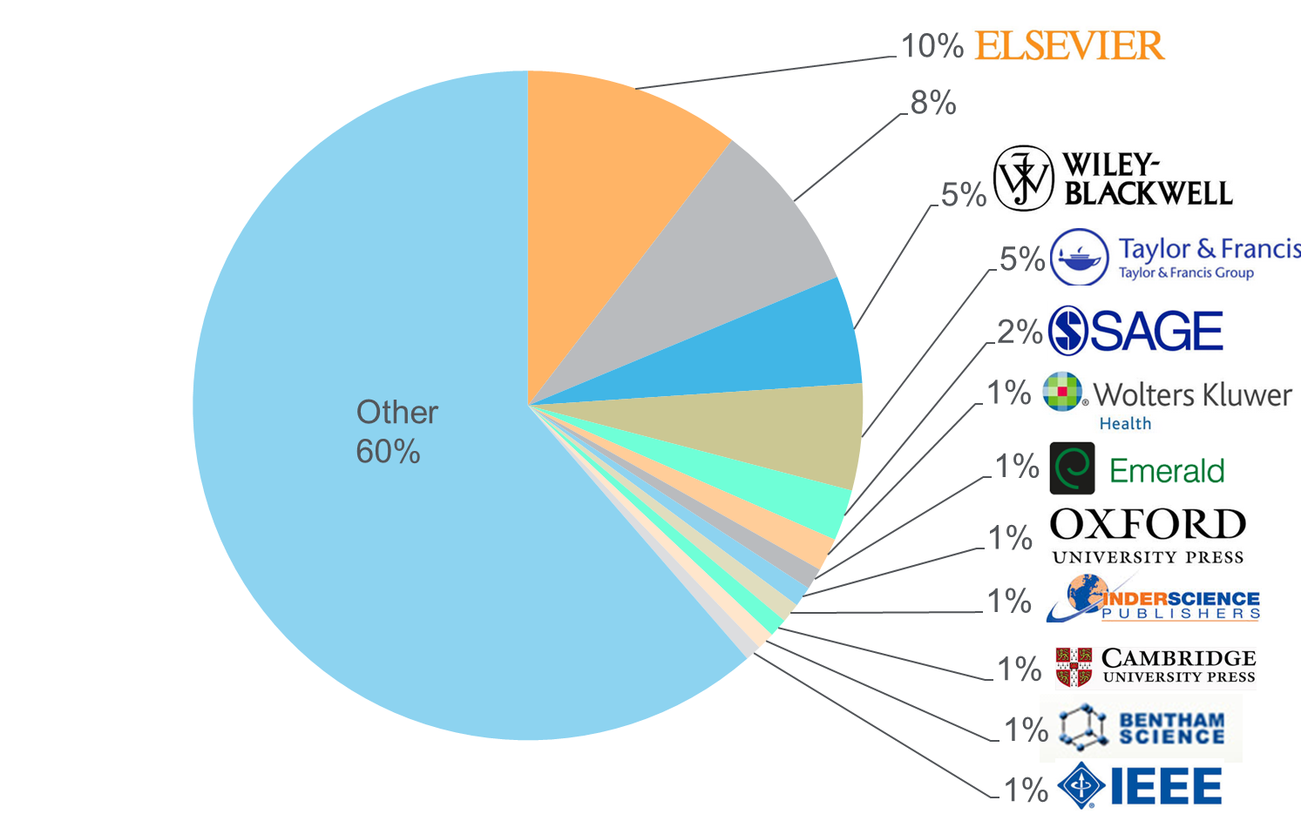

Elsevier是世界最大科技出版社
Source: November 2015 title list at https://www.elsevier.com/solutions/scopus/content
Notes:
Publisher neutral

Slide 5
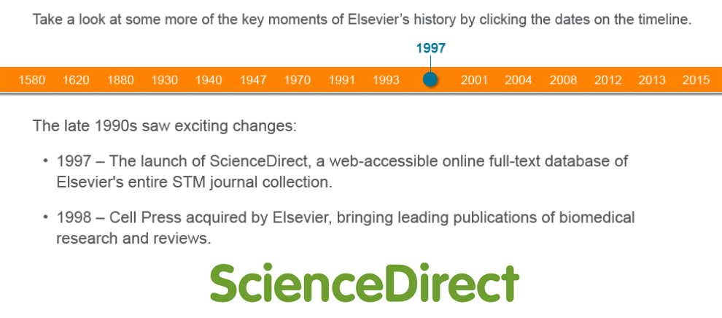
History of Elsevier

Slide 6
ScienceDirect
A ScienceDirect subscription gives you and your patrons access to over:
“ScienceDirect offers an easy to operate platform that provides convenient access to a broad spectrum of interesting and useful research publications.”
15 million publications
3,800 journals & serials, representing more than 612,000 issues
37,000 books including reference works
—Researcher/ Staff Member Life Sciences, USA
Digital archives reaching back as far as 1823

Slide 7
图书内容和期刊论文在研究的不同阶段发挥不同的作用
最新发现
期刊论文
Primary research
期刊论文
Summary of journal articles on a topic
期刊综述
深入学习新知识
学习新方法
In-depth explorations of recent developments and methods in a field
丛书、系列书
图书内容
Complete, advanced and detailed descriptions providing depth in subject areas
电子书（专著）
获取研究
论题相关关系
Compendiums of information / data sets for field or techniques, providing quick answers on the job
Pedagogical examination or didactic presentation of key subject area concepts and methods
教材
背景研究和
知识获取
Comprehensive, foundational introduction to a discipline; encyclopedias
参考工具书&参考模块
Relevance of information over time
图书是基础知识的宝库
Notes:
We can also think about what is going on here in terms of a product hierarchy starting with broad foundations at the bottom represented by Reference Modules or Major Reference Works (MRWs) that presents a comprehensive introduction to established knowledge relating to a subject and an ideal entry point for someone unfamiliar with a topic that quickly need to get up to speed and that provides useful links to further reading.
Moving up the pyramid hierarchy the content becomes gradually more specific and focussed until you get to journals articles that are usually very narrow in focus and provide more detail about more recent findings or theories – often journal represent a number of ‘cutting edge theories’ and approaches on the same subject and can also be seen as ‘work in progress’ or not yet universally established knowledge but essential for new scientific discovery.

Slide 8
数据驱动型出版策略
Scopus & SciVal
Analysis分析
Results结果
追踪期刊活动
文章引用
科研/学科增长
引用影响
重要作者和机构
科研基金
图书使用趋势
制定年度出版计划
创建目标书目
规划寻找“最佳”作者
出版内容，覆盖综合科研成果
定位热门领域，关联突出作者
定位科研缺口
量化想法
基于用户的需求，通过数据分析，开拓广泛的知识，为用户提供高质量的、可信赖的、使用便利的信息资源是我们的使命。

Slide 9











追踪学科发展方向，深入挖掘学科之间的关联，积极开拓和发展交叉学科和新学科资源
Food Science
Fundamental Life Sciences
Energy
Subjects That Are Big and Growing
Chemical Engineering
Transport
Psychology
Environmental & Earth Science
Neuroscience
Chemistry
Economics
Materials Science & Engineering
Biomedical Research
Subjects Where Elsevier Has a Strong Position

Slide 10
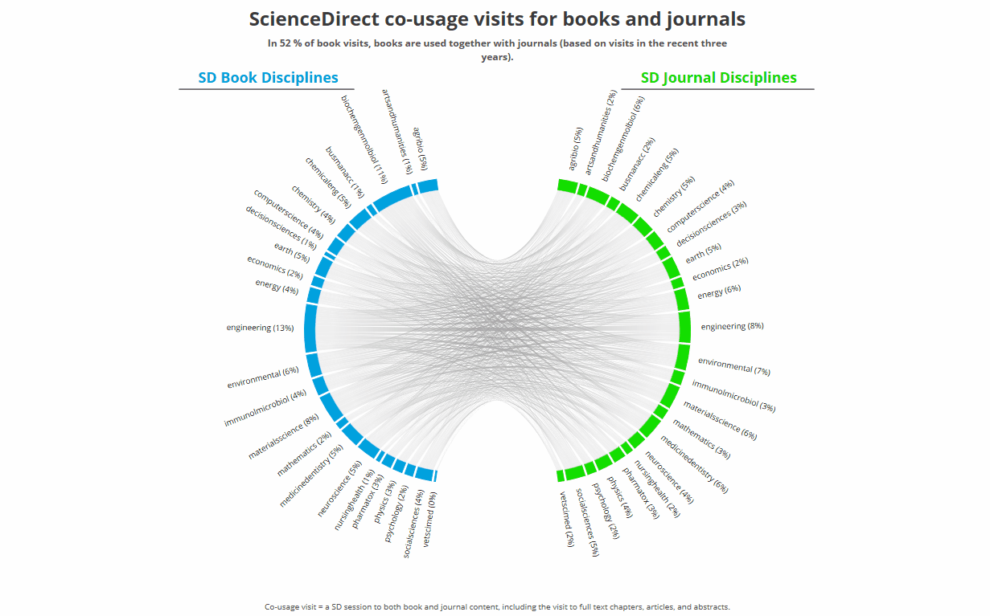
图书内容与期刊文章的共同使用
Notes:
We’re going from Book/Product Centric, to User Centric.
As part of this process, we do regularly qualitative market research to better understand how researchers work with content.
The needs expressed by researchers in these interviews align with the use cases we’ve built for this new initiative:
“I need to get up to speed on a new topic in order to understand the article I’m reading” (Upper and lower left)
“Understanding techniques and processes is required to understand and reuse the results in a paper, but this information is very hard to find.” (Upper and lower right)
“It is a challenge to quickly get a foundation of relevant, authoritative, knowledge on subjects that are new to me” (Upper and lower left)
Yet, with currently available systems, users may be left to fend for themselves in the information ecosystem, visiting different sites, sifting through data to find high-quality, appropriately curated information to learn the answers they need.
As they search, sort, and self-curate for quality, time is lost, which can slow projects down. Worse – questions can remain unanswered, and projects can be stalled or mis-directed by a lack of information.
User data confirms what the qualitative research has demonstrated: books form a critical complement to journal content to ensure researcher success and research growth. Taking a closer look at researchers’ use sessions on ScienceDirect, we see that there is a high-level of co-usage of book and journal content in a given research session.
Details of Slide Visuals:
Taking a closer look at all the use sessions on ScienceDirect, we see that there is a high-level of co-usage of book and journal content in a given usage session. Similar with the co-usage network of an individual book. here in green, you can see book content use, while in red you see journal content use for given subject areas. The larger the circle, the higher the incidence of co-usage is for that subject area content. The three largest green circles show the three subject areas where books are used most often together with journals. So for Engineering, Agricultural and Biological Sciences, and Medicine and Dentistry Book content, users are simultaneously using journal content at the highest rates. What we see here is that book and journal content are complementary content types, each required for specific researcher needs. You’ll note, as well, that this shows the centrality of books within an interdisciplinary research environment. eBooks on ScienceDirect facilitate research that flows from one content type to another, and from one subject area to another, in a given usage session.

Slide 11
ScienceDirect的期刊内容不断增长
Elsevier Published Articles (‘000)
419
436
380
400
365
321
336
284
295
297
258
267
+5% CAGR
2006
2007
2008
2009
2010
2011
2012
2013
2014
2015
2016
2017

Slide 12
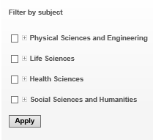
全学科全文数据库 ScienceDirect
物理科学与工程
化学工程学(139)
化学(176)
计算机科学(195)
地球和行星学(161)
能源和动力(98)
工程与技术(324)
材料科学(217)
数学(126)
物理学和天文学(175)
生命科学
农业和生物学(288)
生物化学/遗传学/分子生物学(433)
环境科学(189)
免疫学和微生物学(182)
神经科学(189)
健康科学
医科和牙科(1,395)
护理与卫生保健(204)
药理学/毒理学/制药科学(164)
兽医学 (70)
社会科学及人文
艺术与人文(58)
商业/管理/会计学(142)
决策科学(77)
经济学/计量经济学/金融(130)
心理学(174)
社会科学(318)

Slide 13
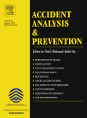
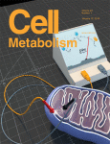
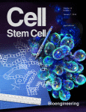
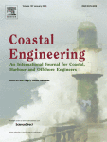
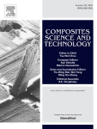
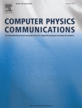
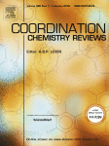
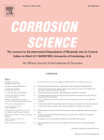
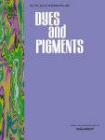
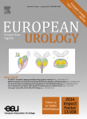
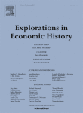

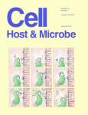
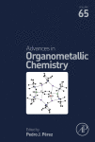
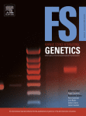
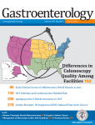
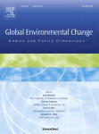
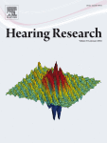
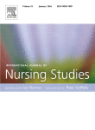
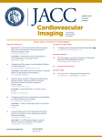
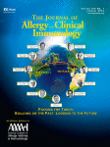
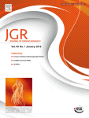
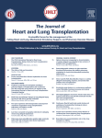
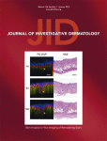
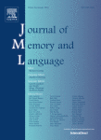
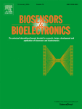
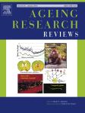
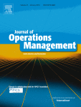
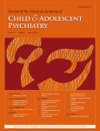
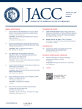
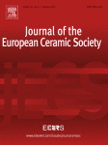
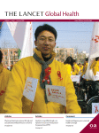
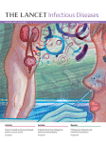
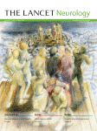
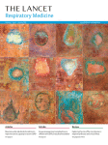
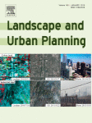
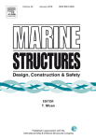
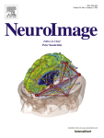
























ScienceDirectz助力北京林业大学科研发展
No.1 in 75 categories out of 235
* Includes one book series Advances in Organometallic Chemistry
Source: Thomson Reuters Journal Citation Reports 2015

Slide 14



























Top Journals in ScienceDirect
Cell Press细胞科学

Slide 15

Cell
CiteScore: 22.79
Impact Factor: 30.410
5-Year Impact Factor: 34.103
Source Normalized Impact per Paper (SNIP): 4.959
SCImago Journal Rank (SJR): 26.947
创刊时间：1974年1月
期刊简介：
Cell发表在实验生物学领域的发现，包括但不限于细胞生物学、分子生物学、神经科学、免疫学、病毒学和微生物学、癌症、人类遗传学、系统生物学、信号传导和疾病机制和疾病治疗。上述领域的研究结果若能够提供重要的概念上进展，或提出了一个有趣而又重要的生物学问题，期刊将非常乐意发表。
期刊刊发综述和评论文章，内含生命科学的所有领域的最新进展。除此以外，Cell还会发表评论，会议评论，给编辑的信件，书评，以及会议和列表。
杂志主页： https://www.sciencedirect.com/journal/cell

Slide 16
Our journals are ranking highly in every field
Journal ranking—Citescore
Journal ranking—Impact Factor
Share of top–10% journals
Subjects with top rank (All Science Journal Classification)
Share of top–10% journals
Subjects with top rank
(Journal Citation Reports)
107
29%
75
32%
14%
12%
34
13%
15%
27
27
30
3%
10
3%
10
Elsevier
Company A
Company B
Company C
Elsevier
Company A
Company B
Company C
Elsevier
Company A
Company B
Company C
Elsevier
Company A
Company B
Company C
Journal ranking by CiteScore across 330 subjects per Scopus Metrics database; source: Scopus data (2016)
Journal ranking by Journal Impact Factor across 234 subjects per Clarivate’s Journal Citation Reports database; source: Clarivate data (2016)

Slide 17













Elsevier启动了从“内容”到“内容 + 技术”的创新转换。Elsevier通过与中国科研机构的图书馆、规划办公室、研究人员以及其他相关人员的合作，我们可以为科研人员提供信息支持服务
CONTENT 内容
解决方案
Elsevier eBooks, Online Journals, Databases
Elsevier
Research Intelligence
Elsevier
R+D Solutions
Elsevier
Clinical Solutions
Elsevier
Education
PLATFORMS
Over the last
50 years the majority of Noble Laureates have published with Elsevier
Founded over
130 years ago
Employ over
7,000 employees
in 24 countries
Published over
360,000 articles
in 2014
Received over
1.1 million submissions in 2014
Work with over
30 million
Scientists, students, health & information professionals
Over 55 million items indexed by Scopus
Notes:
OPTIONAL – For use for audiences less familiar with Elsevier
[Slide goals: introduces Elsevier as a global research collaborative, with ample data resources to build the right research at the right time, in the right place, to serve researcher needs and goals.]
So who is Elsevier?
We are is a digital information solutions company with roots in publishing world class, peer-reviewed scientific, medical, and technical literature, going back 130 years.
Our mission is to lead the way in advancing science, technology and health.
Our customers are doing momentous things and we have a responsibility to create highly effective solutions that enable our customers to leverage the vast potential of information to advance science, health and technology in ways that they could not do alone.
We also want to anticipate the new ways customers will want to use information in the future. That is what we mean by ‘leading the way’.
Our products include:
Intellectual content—largely in the form of digitized books, journals, and proprietary databases—delivering access to them via the internet and other offline digital channels (examples: journals (Lancet, imprints (Cell, MK), ScienceDirect, Mendeley, Scopus)
In addition to—and layered over—this content, are technology and analytics (tools and solutions), that allow clients and end-users to do ‘more with’ information: to produce it, interact with it, manipulate it, and share it with greater facility, efficiency, and creativity (examples: ClinicalKey, Reaxys, SciVal, SimChart)
Elsevier empowers knowledge professionals to be more collaborative and competitive, efficient and effective; to perform better, and to create knowledge with impact.

Slide 18


北京林业大学整体科研产出情况（2014年-2018年）
近年来，学校的研究人员数量和科研产出均在提升，且科研产出分布于多个学科中
数据来源：Scopus & SciVal, 2019年3月；数据时段2014年-2018年

Slide 19


文章的数量与影响力（2014年-2018年）
发文数量
文章影响力
数据来源：Scopus & SciVal, 2019年3月；数据时段2014年-2018年

Slide 20




ScienceDirect 助力北京林业大学科学研究
2018年北京林业大学的研究人员在ScienceDirect平台引用文献7823篇；
2018年，北京林业大学研究人员将178篇文章发表在ScienceDirect平台上。
被引
阅读
Add Logo
引用
发表
Source: Elsevier Web Analytics Department, Scopus Data 2018

Slide 21



ScienceDirect 助力北京林业大学科学研究
北京林业大学对各出版社文献的引用情况
北京林业大学发表文章在各出版社的分布
2015-2018年，北京林业大学研究人员对科研文献的引用、发表和被引用呈上升趋势。
ScienceDirect平台文章是上述上升趋势的主要贡献平台。
北京林业大学发表在不同出版社的文章传播情况

Slide 22

北京林业大学ScienceDirect平台使用情况
2016-2018年，北京林业大学研究人员对ScienceDirect平台使用效率逐年增加。

Slide 23




北京林业大学知名专家对Elsevier不同年代文献有良好使用记录 ——孙润仓教授 长江学者
2012-2018：
孙教授引用Elsevier出版文献4,692篇，主要2005-2012年间占50%以上，且分布于多个学科中

Slide 24




北京林业大学知名专家对Elsevier不同年代文献有良好使用记录 ——王强 教授
孙教授引用Elsevier出版文献2,130篇，主要2005-2012年间占65%以上，且分布于多个学科中

Slide 25

2018年北京林业大学对回溯内容存在潜在需求
Pre 1995
(7.5%)
1995-2004
(23.9%)
2005-2012
(68.7%)
2018年北京林业大学拒访文献出版年代分布

Slide 26



生态学优质期刊推荐
Trends in Ecology & Evolution
Trends in Ecology & Evolution (TREE) contains polished, concise and readable reviews, opinions and letters in all areas of ecology and evolutionary science. It serves as an invaluable source of information for researchers, lecturers, teachers, field workers and students. Trends in Ecology & Evolution keeps these scientists informed of new developments and ideas across the full range of ecology and evolutionary biology - from the pure to the applied, and from molecular to global. Now, more than ever before, is it necessary for life scientists to be aware of research from a wide range of disciplines, especially in the face of the gathering momentum of global environmental change and destruction. More than any other journal, Trends in Ecology & Evolution is the major forum for coverage of all the important issues concerning organisms and their environments.
IF:15.938, Citescore: 10.35
Biological Conservation
Biological Conservation is a leading international journal in the discipline of conservation science. The journal publishes articles spanning a diverse range of fields that contribute to the biological, sociological, ethical and economic dimensions of conservation.
IF:4.66, Citescore: 4.63
Ecosystem Services
Ecosystem Services, associated with the Ecosystem Services Partnership (ESP), is an international, interdisciplinary journal that deals with the science, policy and practice of Ecosystem Services in the following disciplines: ecology and economics, institutions, planning and decision making, economic sectors such as agriculture, forestry and outdoor recreation, and all types of ecosystems.
IF:4.83, Citescore: 4.295

Slide 27


化学优质期刊推荐
Tetrahedron Letters provides maximum dissemination of outstanding developments in organic chemistry. The journal is published weekly and covers developments in techniques, structures, methods and conclusions in experimental and theoretical organic chemistry. Rapid publication of timely and significant research results enables researchers from all over the world to transmit quickly their new contributions to large, international audiences.
Tetrahedron publishes full accounts of research having outstanding significance in the broad field of organic chemistry and its related disciplines, such as organic materials and bio-organic chemistry. Tetrahedron also publishes thematic collections of papers as special issues and 'Reports', commissioned in-depth reviews providing a comprehensive overview of a research area. Tetrahedron also publishes specially commissioned review articles - Tetrahedron Reports - and collections of original papers - Tetrahedron Symposia-in-Print.

Slide 28
History of Elsevier
ScienceDirect
Search Tips
New Features
Q & A

Slide 29



fishery
简单检索
高级检索

Slide 30


简单检索

Slide 31


简单检索

Slide 32

简单检索

Slide 33



简单检索

Slide 34
高级检索

Slide 35

高级检索
fisheries research
2018
management

Slide 36


高级检索

Slide 37

高级检索

Slide 38

高级检索

Slide 39


www.sciencedirect.com

Slide 40




SD 主页
快速搜索及高级搜索
四大学科类型
开放获取

Slide 41

打开SD主页，用自己的用户名密码登录后，下方Activate remote access按钮
Notes:
Open the SD homepage, click on the right up button, the activate remote access button would appear.
Click the activate remote access button.

Slide 42


论文评价度量指标

Slide 43

ScienceDirect主题帮助研究人员发现工作流中的关键信息
Example: think about how we understand a new or unfamiliar concepts we find in a journal article
举例：想想我们如何理解一篇期刊文章中的一个新概念或不熟悉概念
Latest Research
最新研究
Methods
方法
Fundamentals
基础
Definitions
定义
Notes:
So building on that idea we created a concept prototype that we tested with users
The prototype was centred on a common interdisciplinary use case that we had heard regular in user interviews – ‘I want to understand the journal article’
The scenario is that a researcher finds a term in an article that they are unfamiliar with – instead of providing a list of all content that relates to that concept, we signpost the content based on the problem it solves for that specific user – so latest developments, methods, fundamentals or definitions – this allows the user to more clearly navigate to the most relevant content for them
This is the basic principle we are building our solution from – a user-centric view of the content

Slide 44



ScienceDirect主题帮助研究人员发现工作流中的关键信息
1
2
每个主题页面都提供权威的介绍性概述，帮助研究人员、学者和学生理解和解释科学文献
ScienceDirect主题页面可以在跨学科研究中快速进入新的主题领域，并为学生学习新概念或理解期刊文章提供一个简单的、交互式的工具
3
1
简短定义*
2
相关内容
3
摘自相关书籍内容
*When a short definition is not available, the longer definition can be found in Book excerpts

Slide 45


实例展示
同聚Elsevier旗下的ScienceDirect和Mendeley在文献检索管理方面可以完美融合，为用户提供一站式的解决方案

Slide 46








什么是Mendeley?
与SD对接，是文献管理工具，下载和管理文献
科学世界微博，更新自己科学成果，同时关注业界大牛
推荐个性化科学内容，让科学世界尽在掌握

Slide 47

利用ScienceDirect——Mendeley管理文献
https://www.mendeley.com

Slide 48

利用ScienceDirect——Mendeley管理文献

Slide 49

利用ScienceDirect——Mendeley管理文献

Slide 50

利用ScienceDirect——Mendeley管理文献

Slide 51


或在Mendeley中进行文献的阅读和管理
双击加入的词条，便可自动下载，并跳转至全文阅读页面

Slide 52

Import references from 3rd party site
1
3
2

Slide 53

Mendeley中进行文献阅读，标注和评论。以及查看文献的书目信息

Slide 54


Mendeley帮助研究人员展示成果提升影响力
展示研究成果
评估影响力

Slide 55


手机检索

Slide 56
THANK YOU

